Slide 1
Big Data – Amazon Web Services Week 6
Professor Arturo Castellanos, PhD
Assistant Professor – William & Mary
Big Data - MSBA

Slide 2

3 Ways to Interact with AWS Services
AWS Management Console
Command Line Interface (AWS CLI)
Access to services by discrete commands or scripts
Software Development Kits (SDKs)
Access services directly from your code (e.g., Java, Python, others)

Slide 3
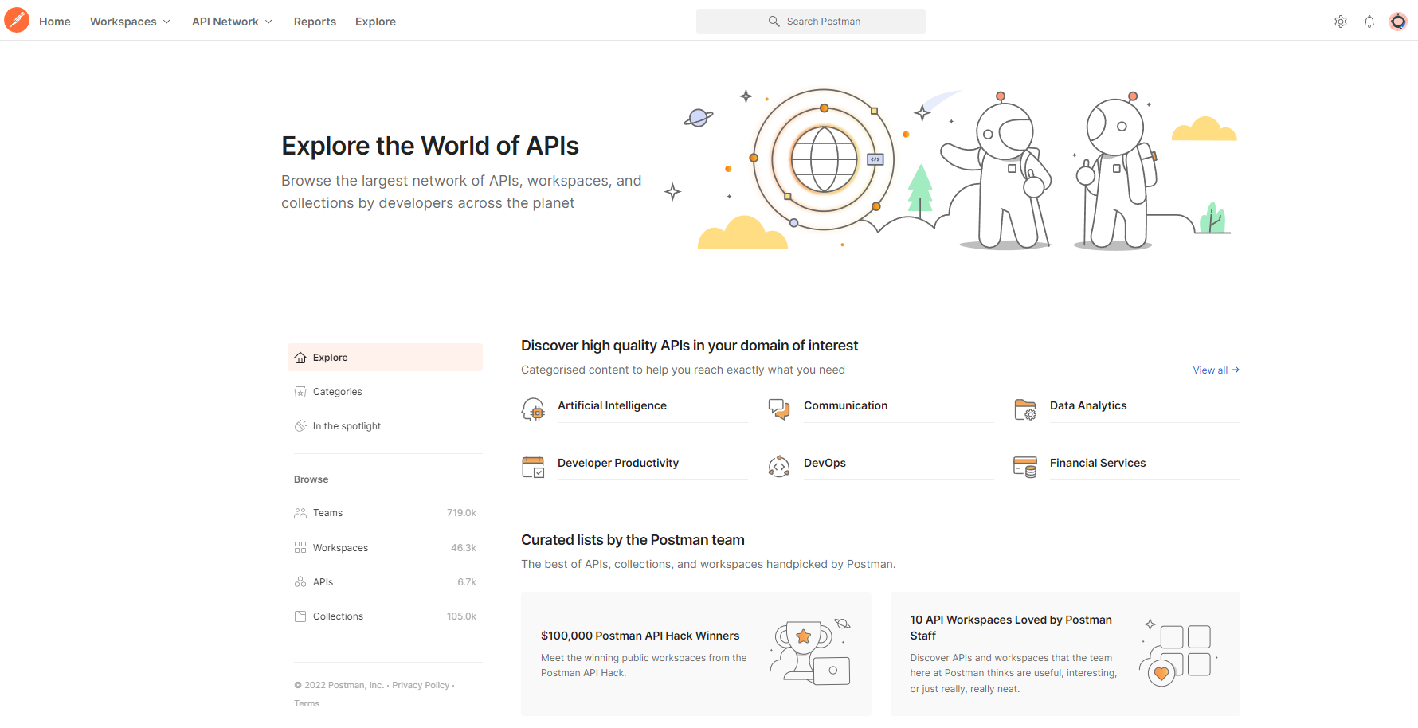

Slide 4
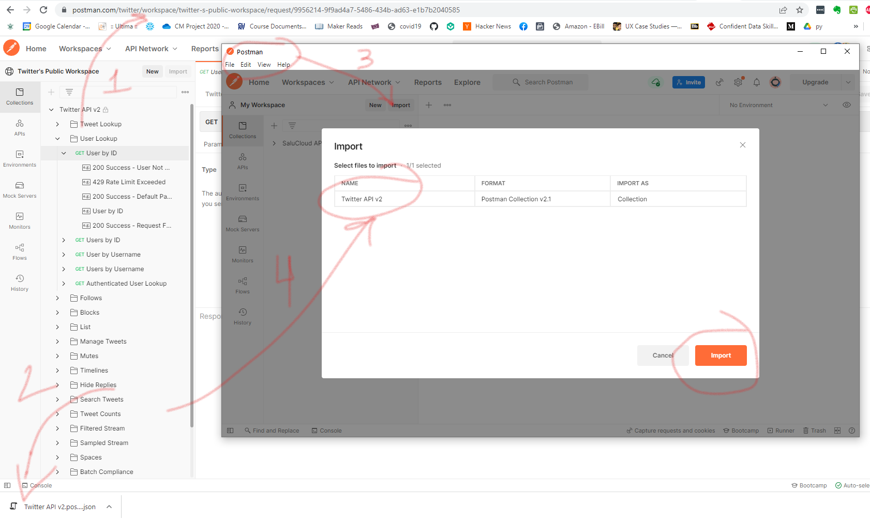

Slide 5
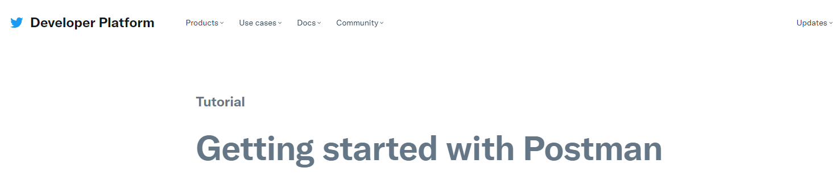
https://developer.twitter.com/en/docs/tutorials/postman-getting-started
Before next class: Request your AWS credentials (developer.twitter.com) and run the Jupyter notebook I provided with your credentials.

Slide 6
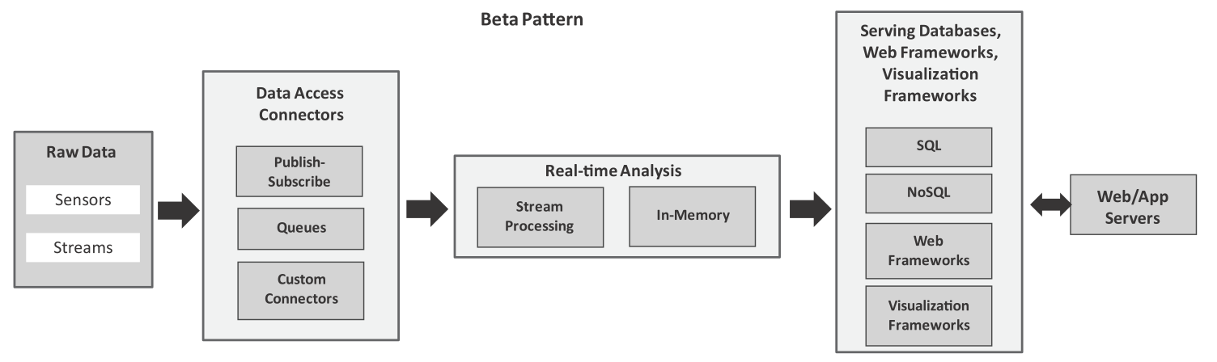
Analytics Patterns: beta pattern
Beta pattern
This pattern can be used for ingesting streaming data using publish-subscribe messaging frameworks, queues and custom connectors. For real-time analysis, we can use stream processing frameworks (such as Storm) or in-memory processing frameworks (such as Spark).
Chapter 8 - © 2019 Arshdeep Bahga & Vijay Madisetti

Slide 7
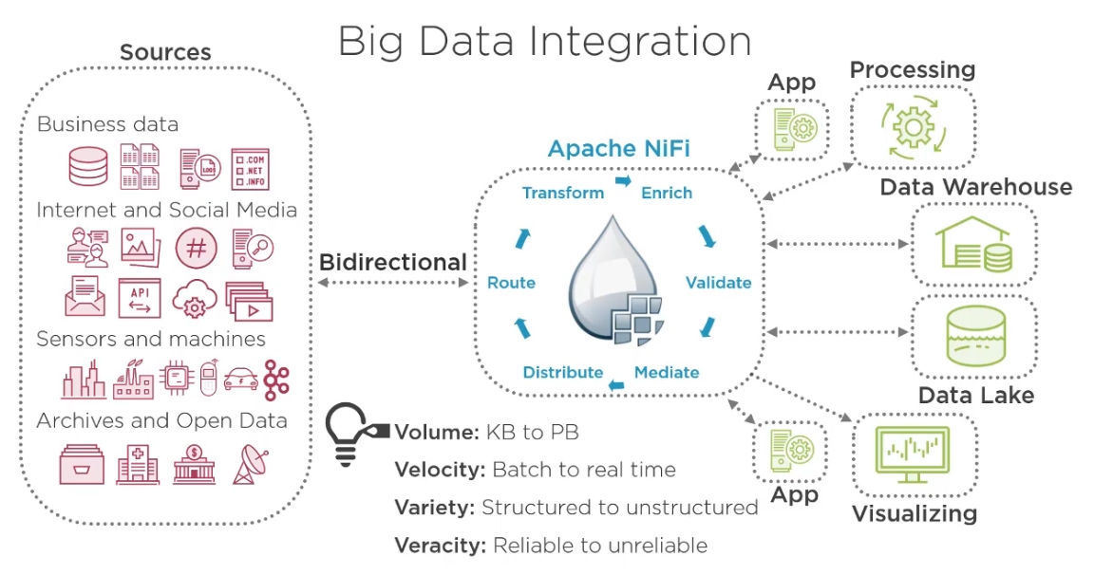
Source: Pluralsight

Slide 8
What is Apache NiFi?
Apache NiFi is a dataflow system based on the concepts of flow-based programming. It supports powerful and scalable directed graphs of data routing, transformation, and system mediation logic.
NiFi has a web-based user interface for design, control, feedback, and monitoring of dataflows.
It is highly configurable along several dimensions of quality of service, such as loss-tolerant versus guaranteed delivery, low latency versus high throughput, and priority-based queuing.
NiFi provides fine-grained data provenance for all data received, forked, joined cloned, modified, sent, and ultimately dropped upon reaching its configured end-state.
Nifi User Guide: https://nifi.apache.org/docs/nifi-docs/html/user-guide.html#User_Interface

Slide 9
NiFi
Originally developed by the NSA (open sourced in 2015). NiFi was built with integration in mind:
Handle system failures
Error detection and troubleshooting become more difficult as transactions cross disparate systems
One slow system can become a severe bottleneck in an integration process
Data quality and consistency can vary drastically between systems
Protocols supported for integration vary between systems
New platforms must be rapidly integrated into a corporate environment
Nifi User Guide: https://nifi.apache.org/docs/nifi-docs/html/user-guide.html#User_Interface

Slide 10
NiFi
Facilitates automated dataflow between systems.
NiFi offers solutions for many of the integration challenges that the NSA and other organizations face.
Featuring a browser-based IDE
Re-usable drag and drop processors,
A graphical dataflow diagram, most integrations can be built with little or no coding.
NiFi facilitates many of these patterns used for enterprise integration. It can act as both a sender and a receiver of messages. It can also be used to route, transform, and translate between many message formats and protocols.

Slide 11
NiFi Features
Transfer data reliably and securely between systems
Data collection and preparation of high-velocity data (real-time)
Consuming big data and transforming it for other systems
Data buffering
Prioritized Queueing
Data provenance
Flow templates

Slide 12
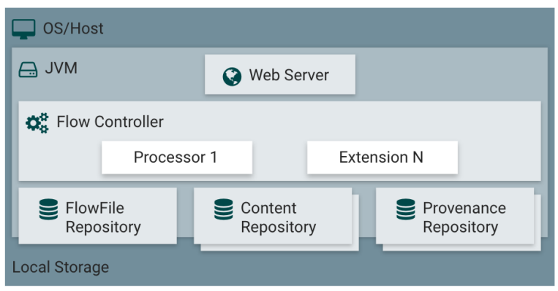
NiFi Architecture
A flow controller acts as the runtime engine. You see three repositories:
▪ FlowFile repo stores FlowFile attributes
▪ Content repo stores FlowFile content
▪ Provenance repo stores history and provenance events

Slide 13
NiFi Concepts
Component Name | Description
FlowFile | Data packet running through the system
FlowFile Processor | Performs data routing, transformation, and data movement
Connection | Actual data linkage between processors
Flow controller | Facilitates the exchange of FlowFiles between the processors
Process Group | Specific group of data inputs and data output processors

Slide 14
NiFi Processors
Process Groups
GetHDFS
FetchHDFS
PutHDFS
MoveHDFS
ExecuteSQL
ConvertJSONtoSQL
PutSQL
FetchS3Object
PutS3Object
Allows for better organization of workflows
Group processes into logical components
Select multiple components using the shift key and then put into a process group
Allows to create templates, export and share them.

Slide 15
Variables and Expression Knowledge
Provides the ability to reference FlowFile attributes, compare them to other values and manipulate their values
Always begins with the start delimiter ${ and ends with the end delimiter }.
Between the start and end delimiters is the text of the Expression itself.
For example, ${filename} will return the value of the filename attribute

Slide 16
Building a DataFlow
Adding Components to Canvas
Configuring a processor
Settings, Scheduling, Properties
Connecting components
Command and control of the DataFlow
Starting/stopping a component
Enabling/disabling a component

Slide 17
Next class
We will create a docker container with NiFi
Lab – two parts (Due March 21st):
Before Wednesday: complete part 1. Make sure to install Docker and get the Twitter Developer credentials before Wednesday’s class. Follow the steps (pages 1 – 4) on the Lab 4 document.
On Wednesday, we will start working on part 2: Twitter streaming
We will discuss the Midterm exam

